Slide 1



CAMERA GALLERY

Slide 2
WHY CAMERA GALLERY?
2013
13.8%
2017
25.2%
Addiction to click photo
2014
17%
Increasing the numbers of clicking photographs
and capturing videos year by year
2016
23.1%
2015
21%
Numbers of clicking photographs per year

Slide 3
F EATURES
Click photo
capture videos
Gallery and
Download
Stream video

Slide 4
What we use?
25 %
60 %
1 5 %
HTML
CSS
JAVASCRIPT

Slide 5
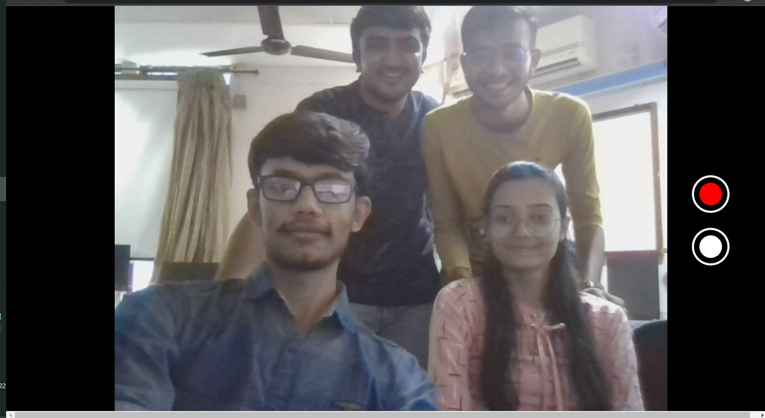
What We Done

Slide 6


Slide 7


Slide 8
thank
YOU
21DCE060
21DCE064

